Slide 1


Kandean
Personalized your own recipes and digital fridge
22207232 Qiyue Zhu
11/4/2024

Slide 2

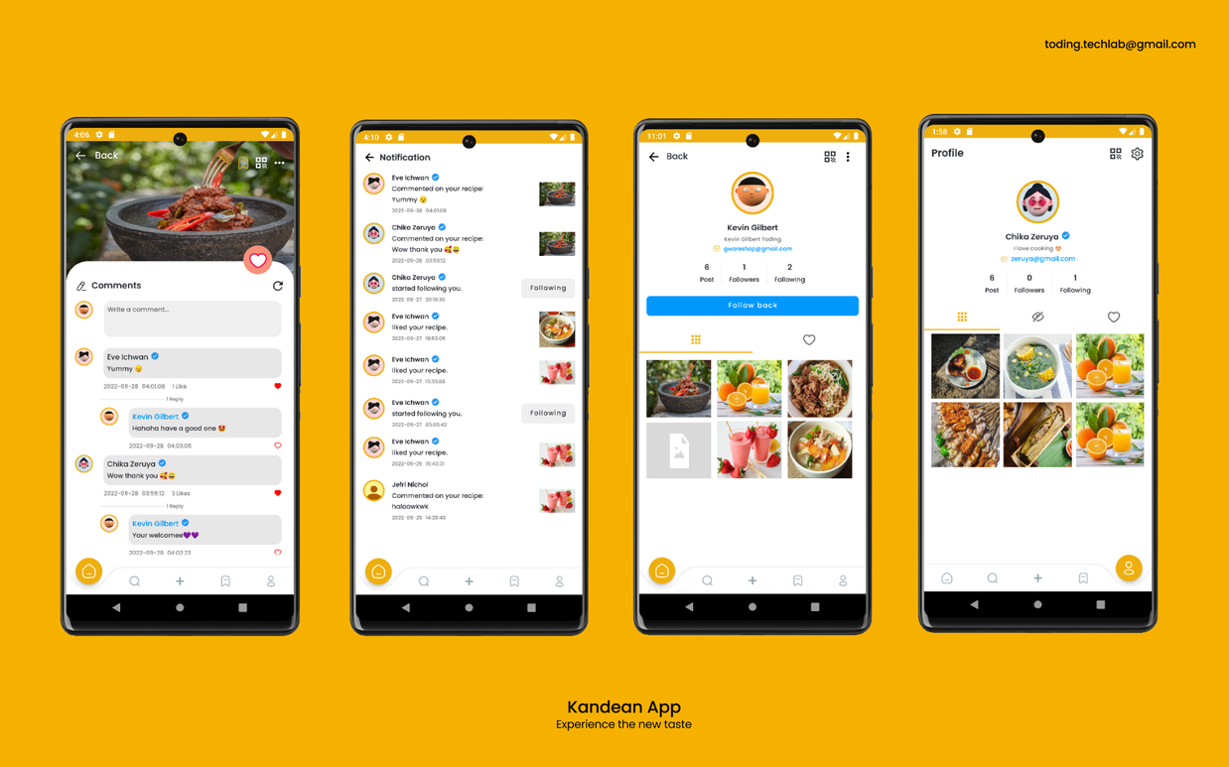
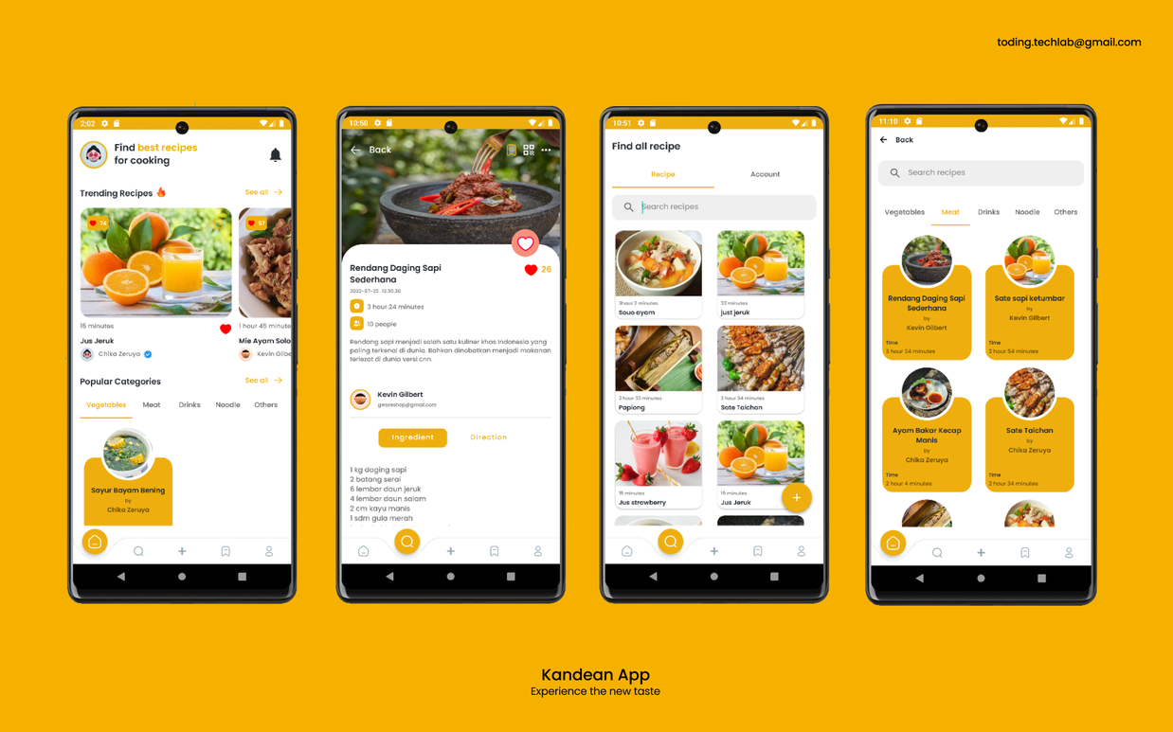
The Chosen App: Kandean
A beautiful UI
Share recipes like Instagram, you can like and comment, and receive notifications when someone likes or comments on your post
Edit your own recipes
Search recipes
Suggest the trending recipes or popular categories
Support QR Code scanning to find recipes and user accounts

Slide 3
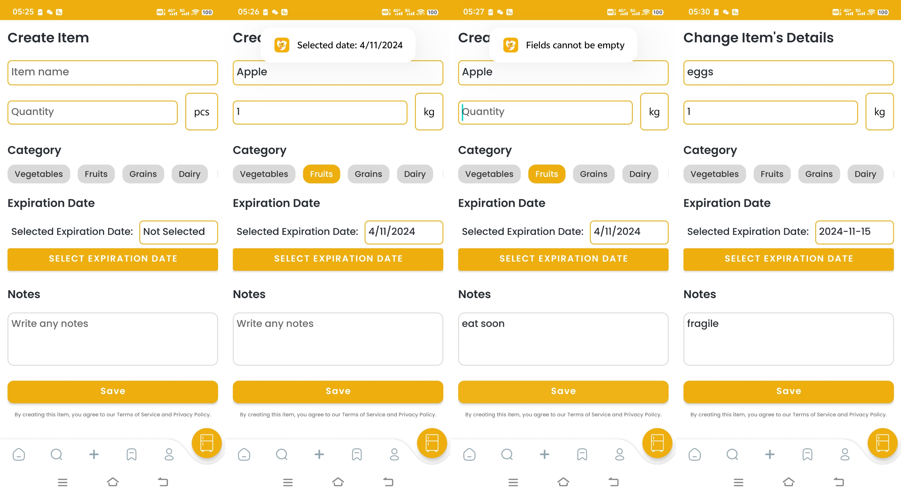
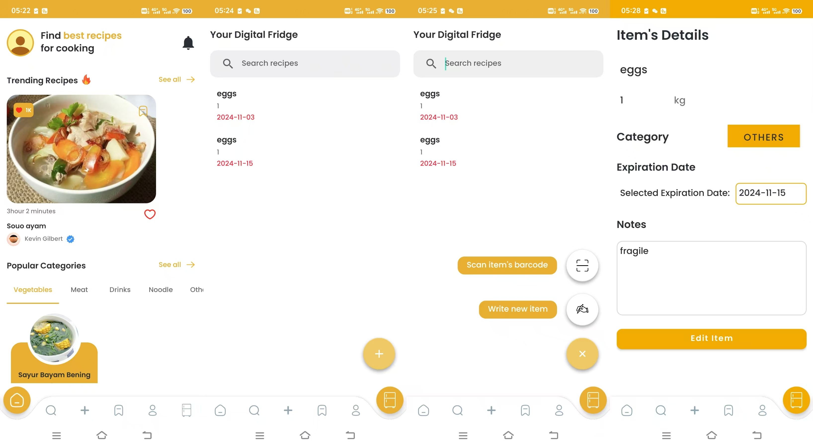
Newly Added Pages

Slide 4






Timeline
Set up the new basic pages and layout of the digital fridge page on the main page
Set up the push notifications, set up the expiration-date-reminder related pages and items
WEEK 4
WEEK 9
Add an API that enables users to scan barcodes or upload receipts and an API that has an expiring time
Fine-tune the UI and test the functions, try to add more functions if enough time is left
WEEK 2
WEEK 7

Slide 5
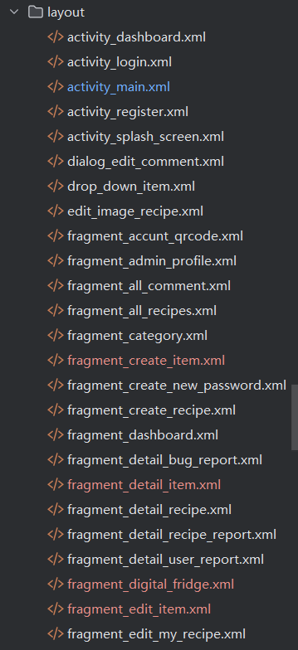
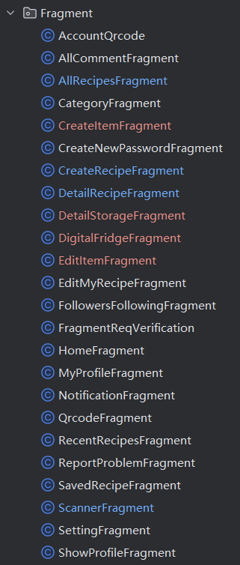
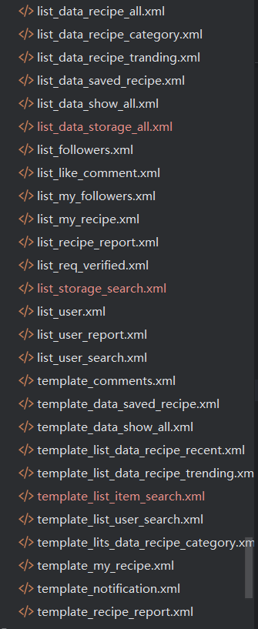
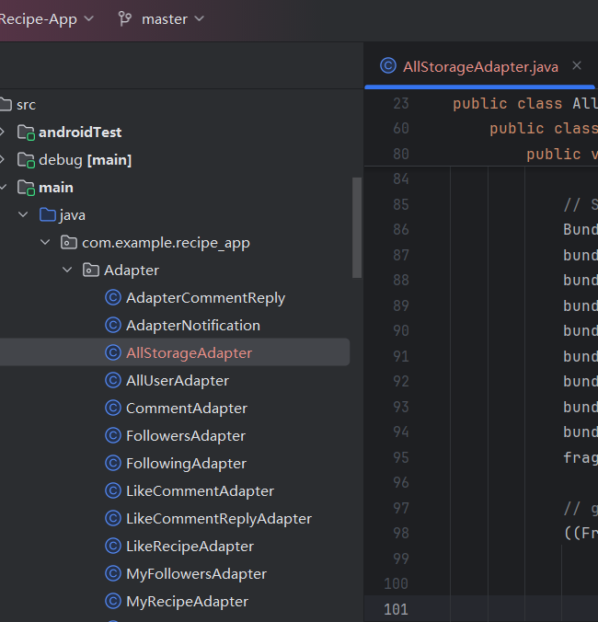
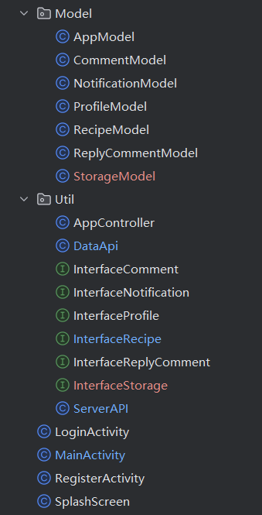
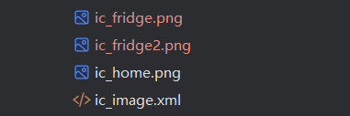


Workload Overview
The code and layout changed

Slide 6
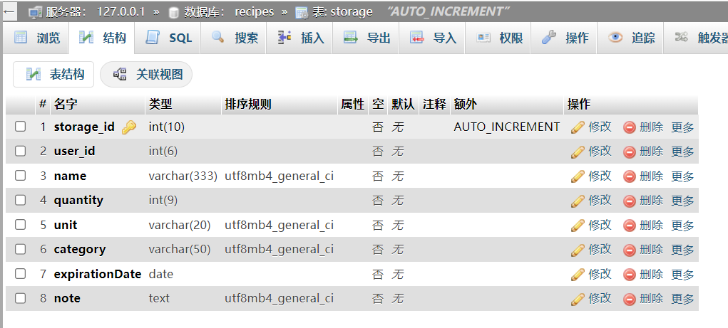
Workload Overview
A new table is created: storage table.

Slide 7
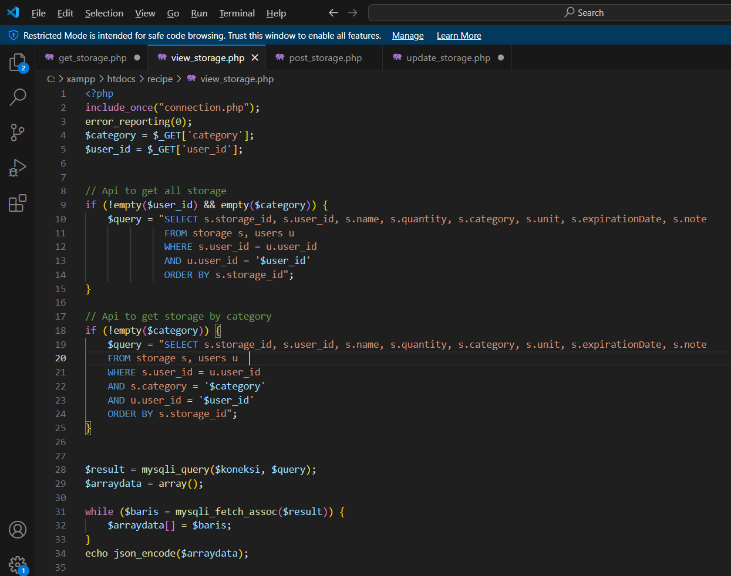
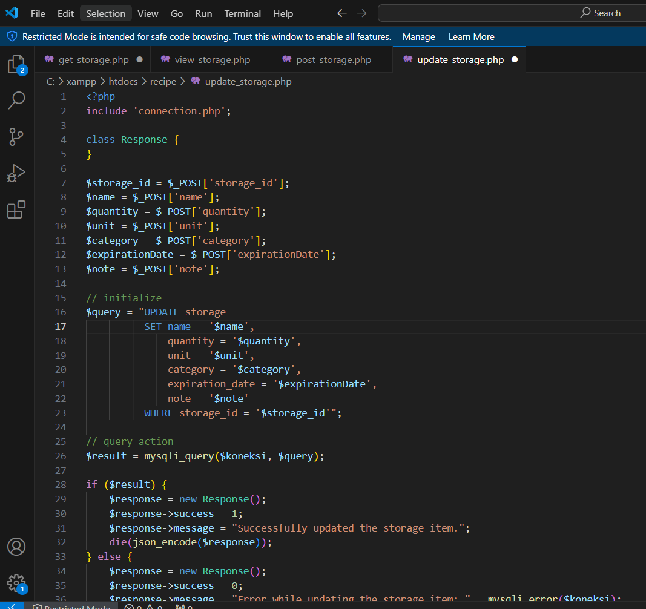
Workload Overview
The php file to translate the database’s language to java String

Slide 8
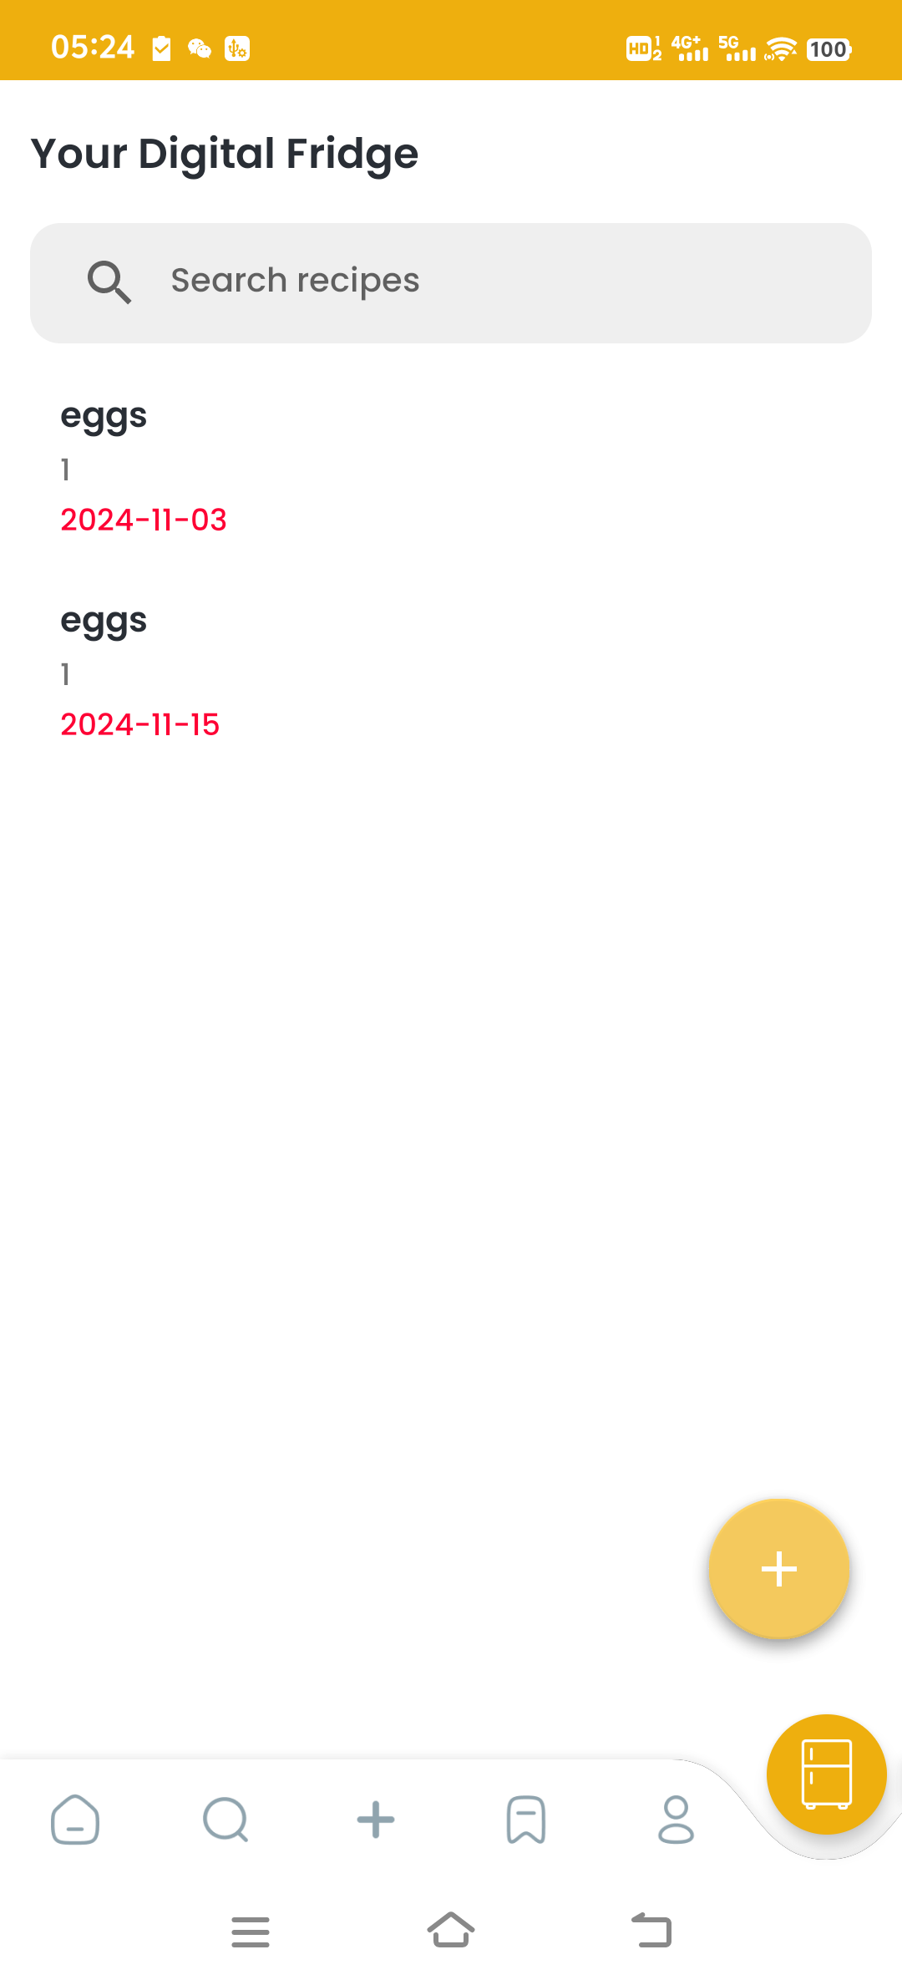
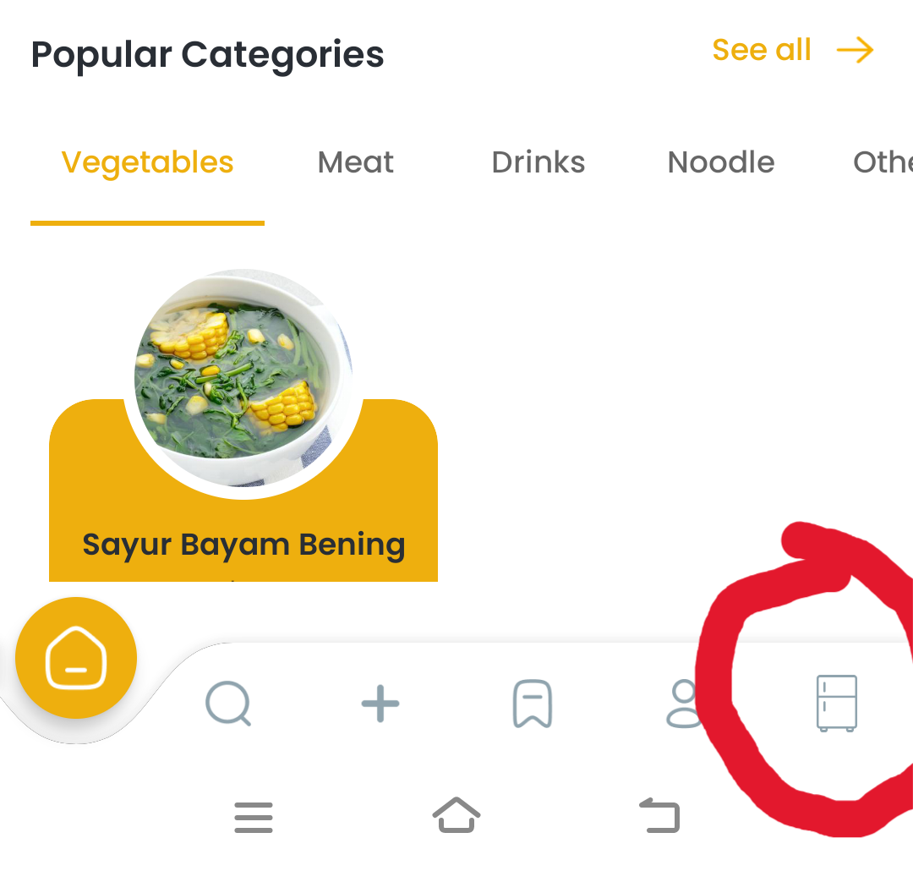
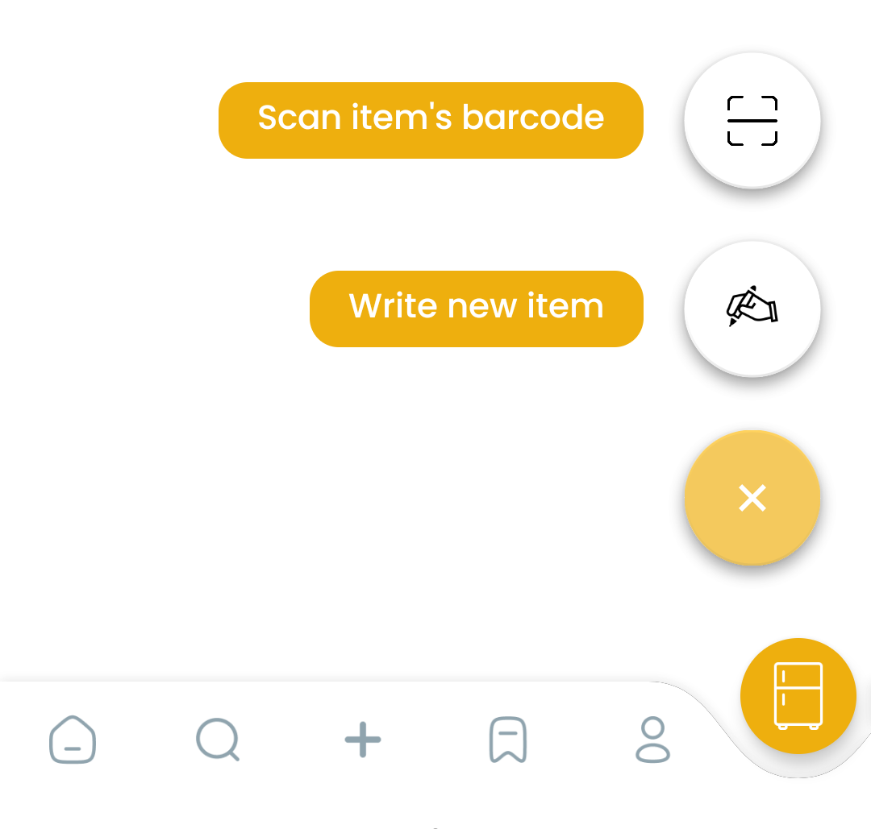
Function Achieved
1
Add a new page of digital fridge
The page can act differently according to the page is displaying or not
Display the items in a tidy form
Have a floating button, and after clicked it will show 2 options: write or scan code
Have the search function

Slide 9
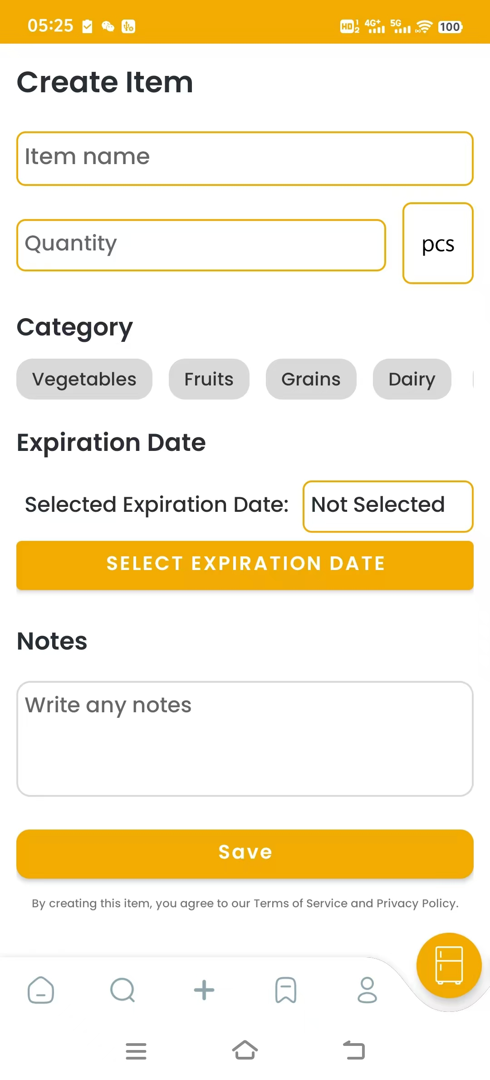
Function Achieved
2
Create A New Item
Can create a new item in this page
The fields should be at least filled with the name, the quantity and the unit

Slide 10
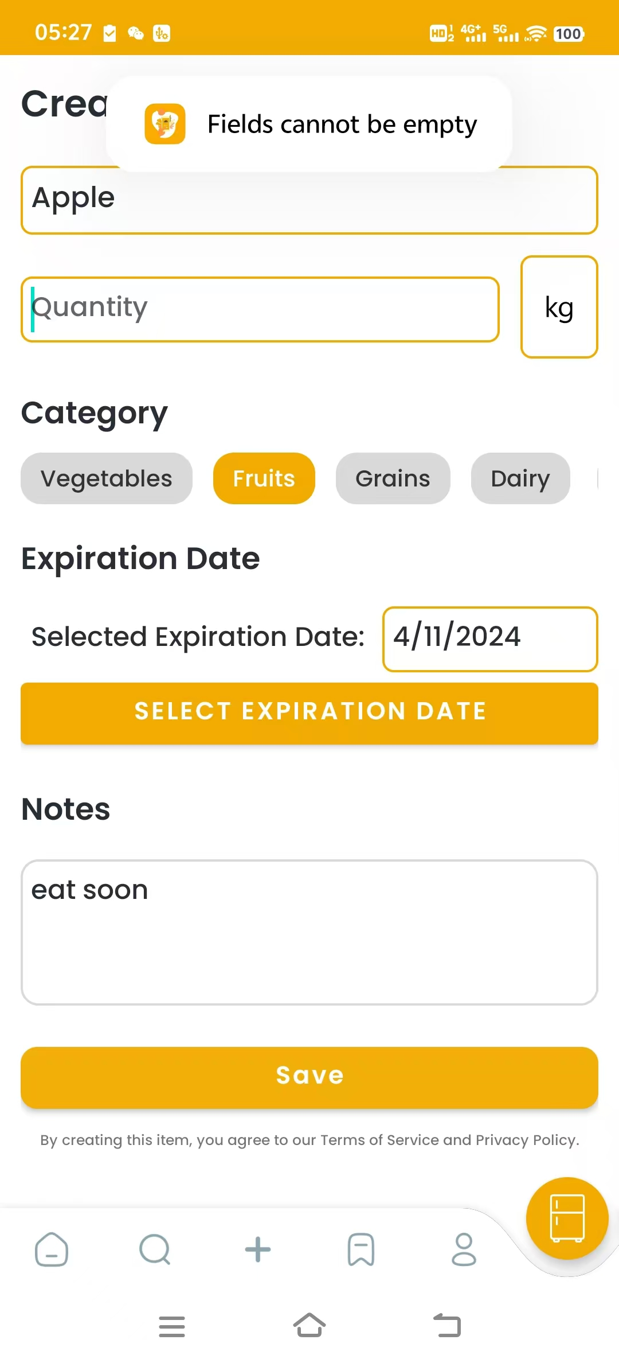
Function Achieved
2
Create A New Item
If you want to save an item without filling up the necessary name or quantity or unit, a message will pop up to remind you

Slide 11
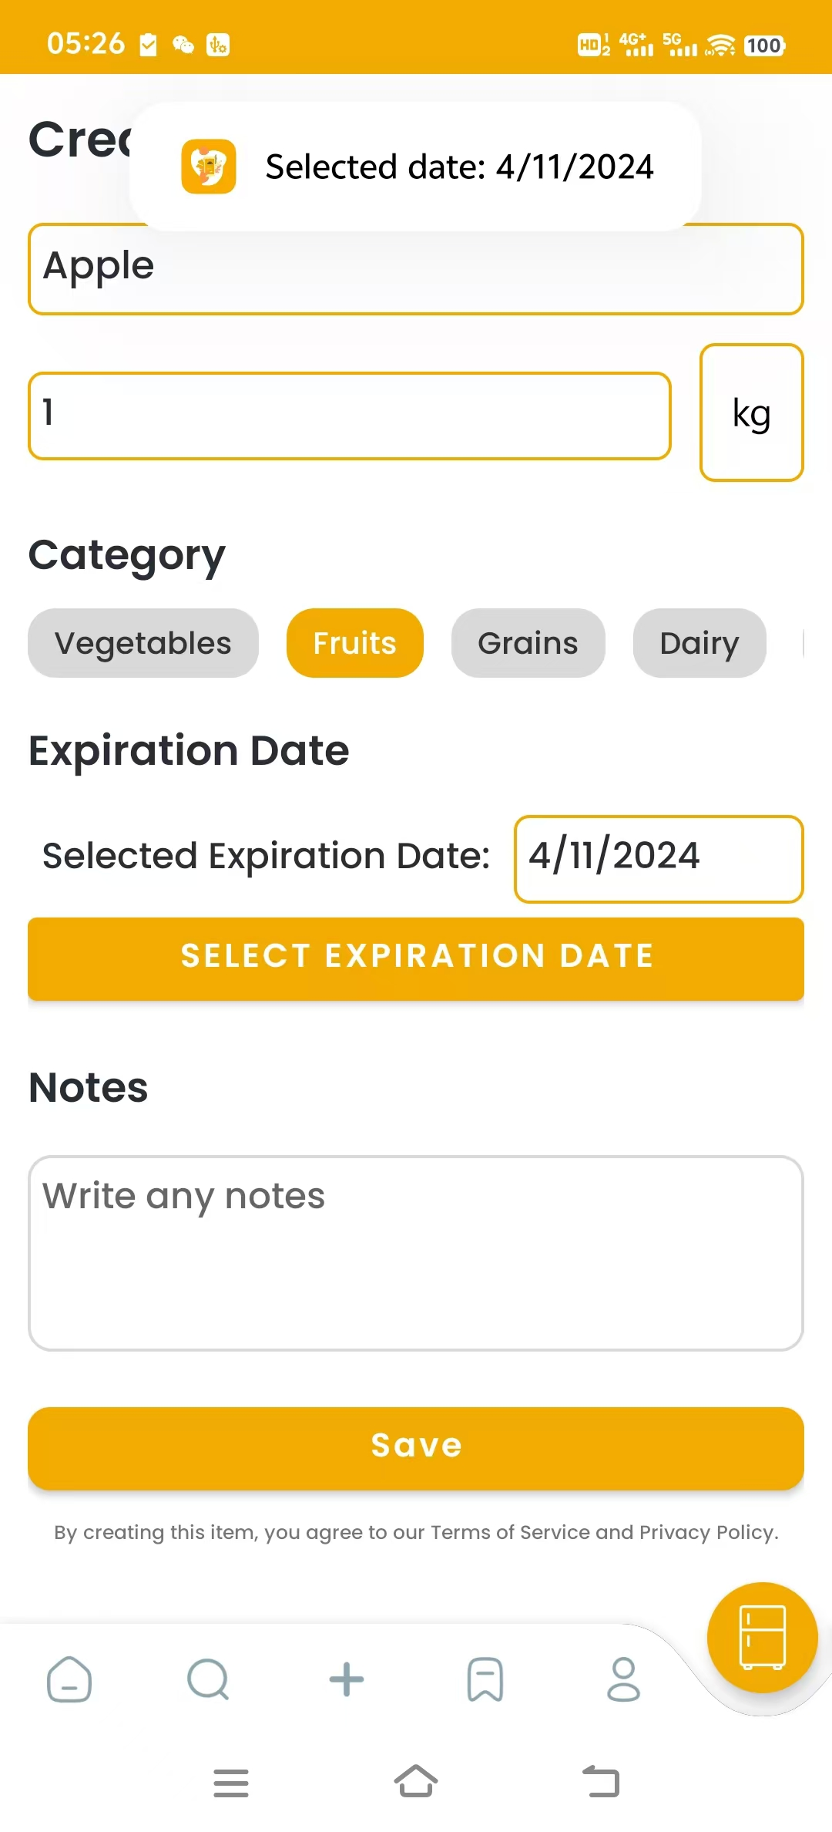
Function Achieved
2
Create A New Item
When selecting an expiration date, a message will pop up to remind you of your choice

Slide 12
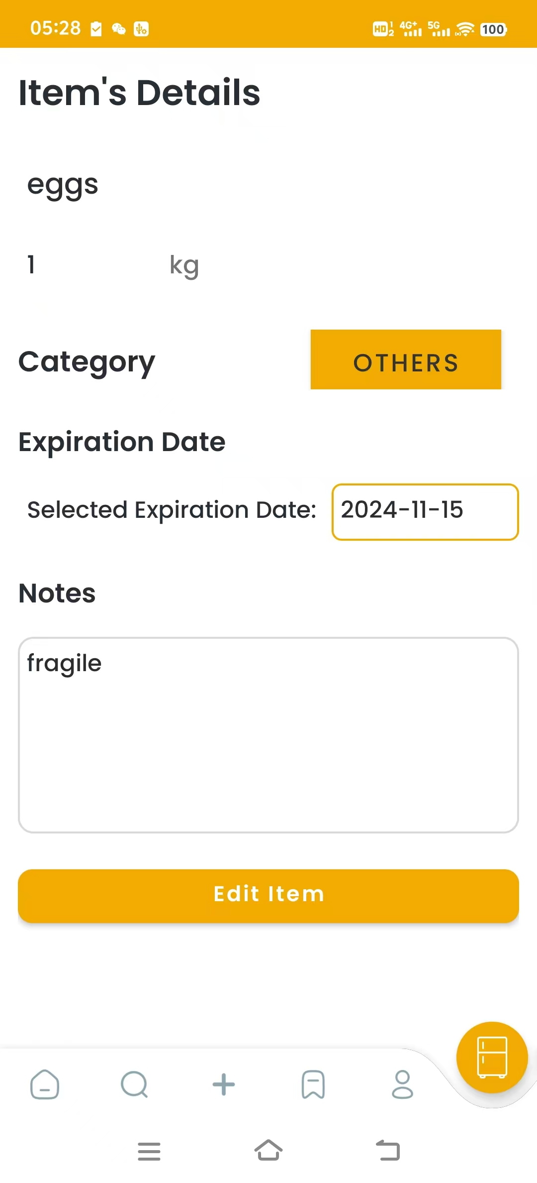
Function Achieved
3
See the Details of An Existing Item
Click the item you want to see and you will get the details of it
To note, if the category is blank, it will be set to “others” when displaying
Click the button below, you can edit it.

Slide 13
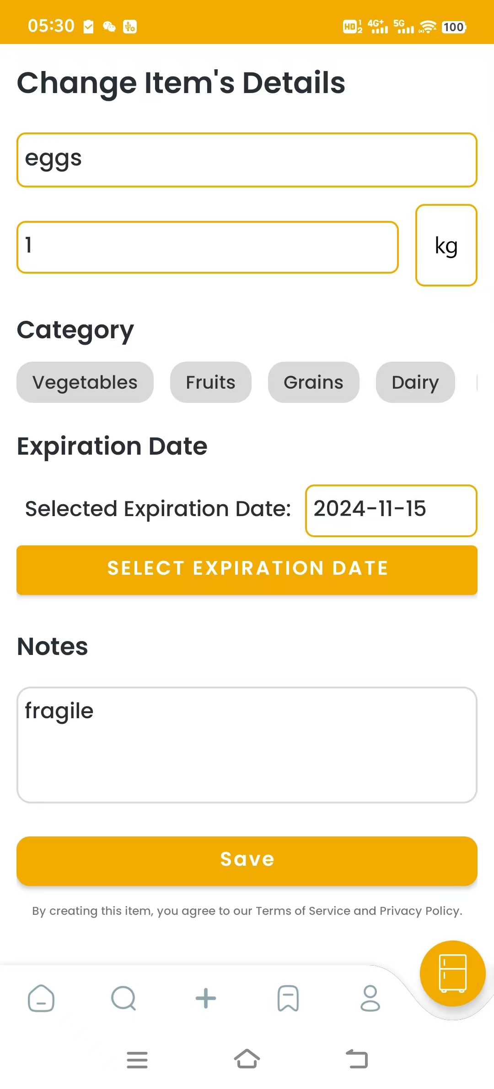
Function Achieved
4
Edit A Existing Item
Basically same with the create page, but the text given have been set.
Clicking save will save the change and return to the home page

Slide 14
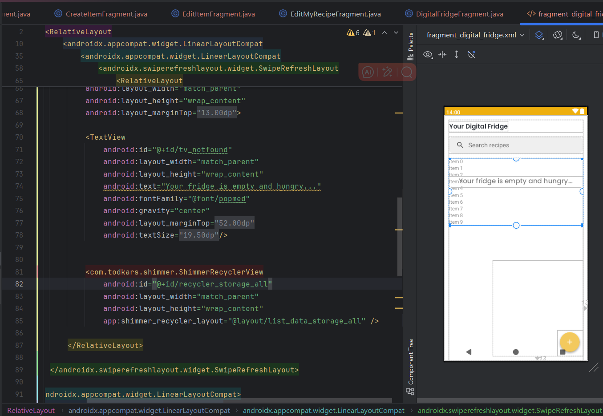
Code explanation (Example)
XML Layouts:
use various layout to set the page
Structure each attribute to a frame to separate clearly. Have a different display for the empty page.

Slide 15
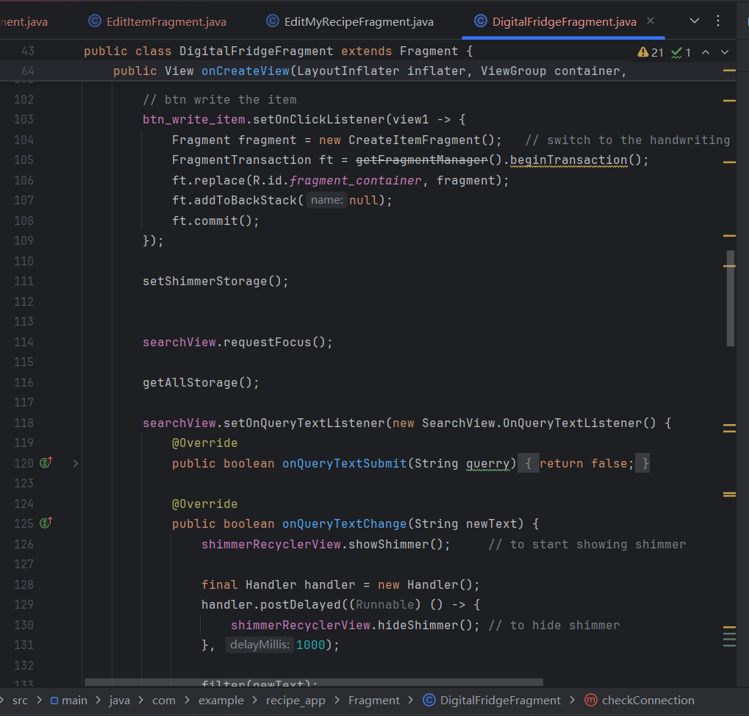
Code explanation (Example)
Fragment Code:
Search item
Floating Action Buttons for scanning new items or adding them through handwriting.
Set pull-to-refresh action for the item list
getAllStorage(): Successful data retrieval populates the RecyclerView with an AllStorageAdapter.
checkConnection()

Slide 16
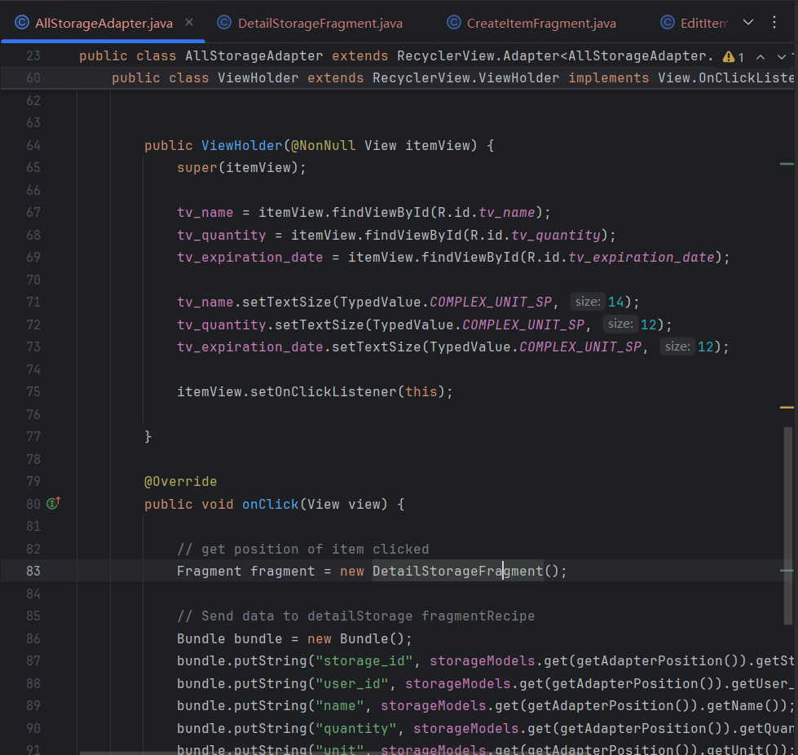
Code explanation (Example)
Adapter Code:
handle the case when the user click a item
transfer the data to the item’s detail page

Slide 17
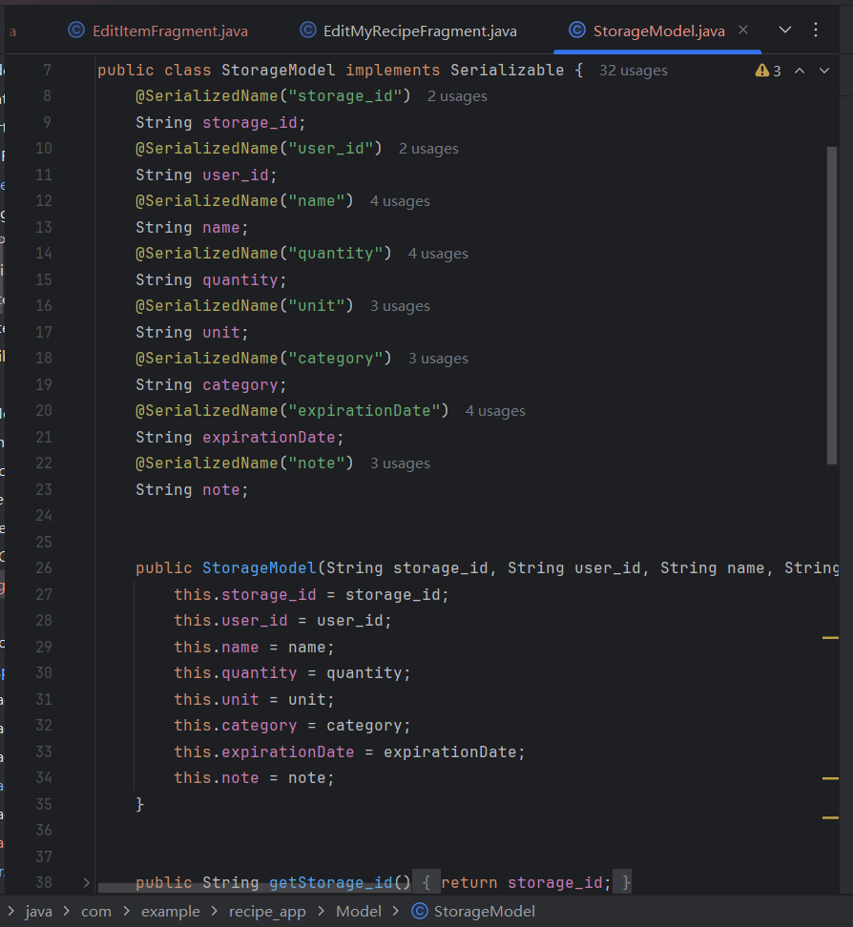
Code explanation (Example)
Storage Code:
defines what a storage item looks like, encapsulating the properties and behaviors associated with each stored item.

Slide 18
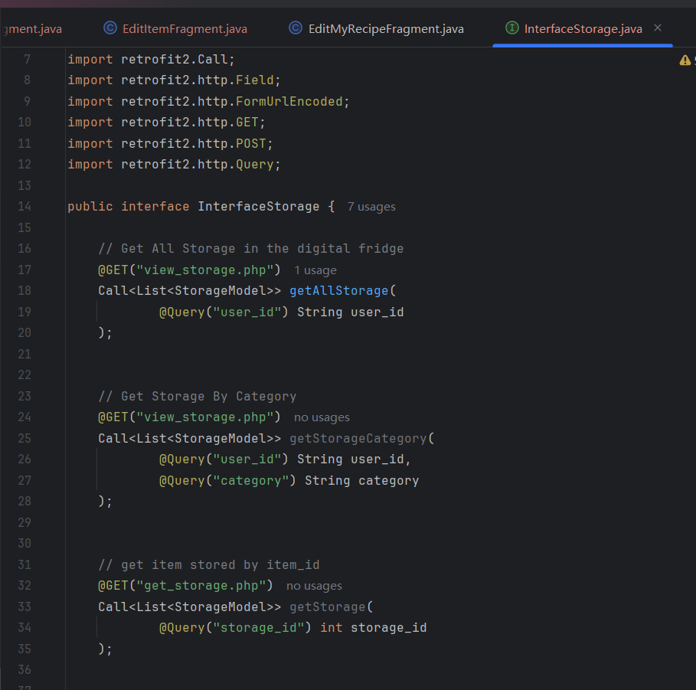
Code explanation (Example)
Interface Code:
defines the API endpoints and the expected HTTP methods needed to manage storage items in your digital fridge application using Retrofit.
By outlining methods such as getAllStorage, createItem, anddeleteStorage, InterfaceStorage.java connects directly with the back-end services via the PHP scripts.

Slide 19
Code explanation (Example)
Set up the connection &
Get the data posted from the project
The code shows how to query and handle the result of searching item in the storage.
If no category got, use user_id to get all items in the storage.
If the category is valid, get all items in the storage which are in this category.
Get the query result and encode it in JSON, transfer to the project.

Slide 20
THANKS FOR WATCHING

